Slide 1


Stroke Prediction
16 December 2021
Rahaf Almayouf , Shatha Alghamdi , Munira Alshahrani

Slide 2

Outline
Introduction
1
2
Workflow
Data Overview
3
4
Exploring Data Analysis (EDA)
Algorithm
5
6
Challenges
Tools
7
8
Conclusion

Slide 3
Introduction
According to the World Health Organization (WHO) stroke is the 2nd leading cause of death globally, responsible for approximately 11% of total deaths. This dataset is used to predict whether a patient is likely to get stroke based on the input parameters like gender, age, various diseases, and smoking status. Each row in the data provides relevant information about the patient.

Slide 4
Targets
Awareness of the most common causes of strokes.
Concluding who are the most susceptible to strokes from people.
Realizing the difference between smokers and non-smokers in having strokes.
Knowing the ages most likely to have strokes.

Slide 5
Workflow
Data Cleaning
EDA
Build Models
Test Model

Slide 6
Data Overview
id | int
age | float
gender | object
hypertension | int
heart_disease | int
ever_married | object
work_type | object
Residence_type | object
avg_glucose_level | float
bmi | float
smoking_status | object
stroke | int
The dataset consists of 12 features and 5110 observations.
Source from Kaggle.
Features description:

Slide 7
Exploring Data Analysis (EDA)
Does age have impact on strokes?
01
02
Does body mass index and glucose levels in a person, propel a stroke?
Assumption: Smoking can induce Stroke, is it true?
03
04
Assumption: Heart with a Heart Disease is prone to Stroke, is it true?
Assumption: Workload results in high blood pressure and that could lead to Stroke, is it true?
05
06
Assumption: Males are most susceptible to strokes due to high work-related stress, is it true?

Slide 8
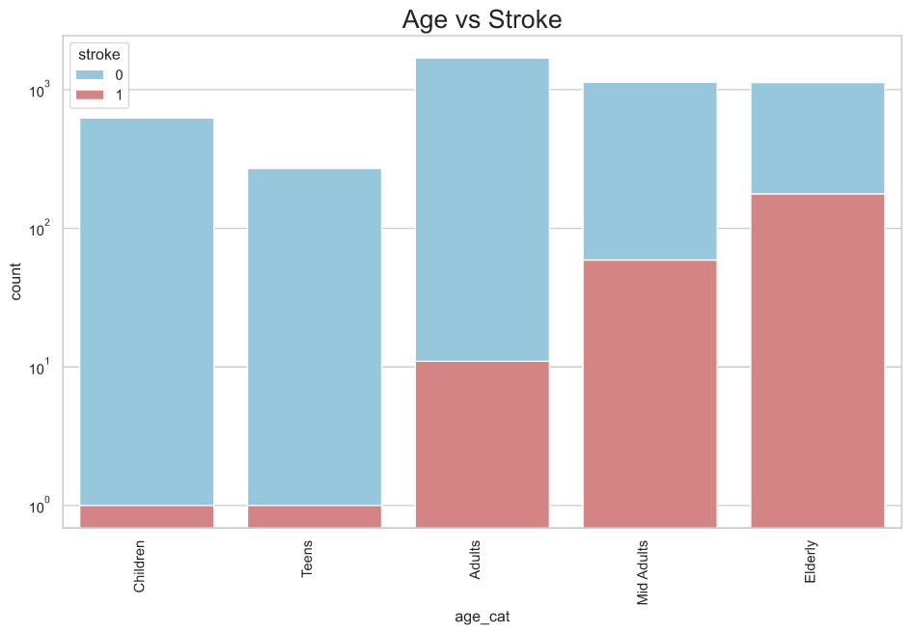
Does age have impact on strokes?
01

Slide 9
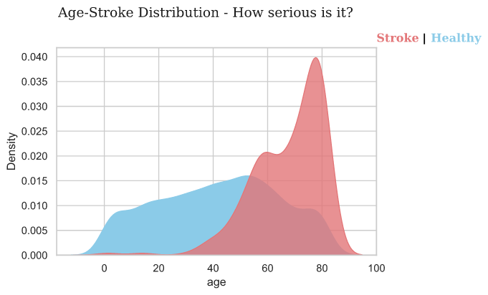
Does age have impact on strokes?
01

Slide 10
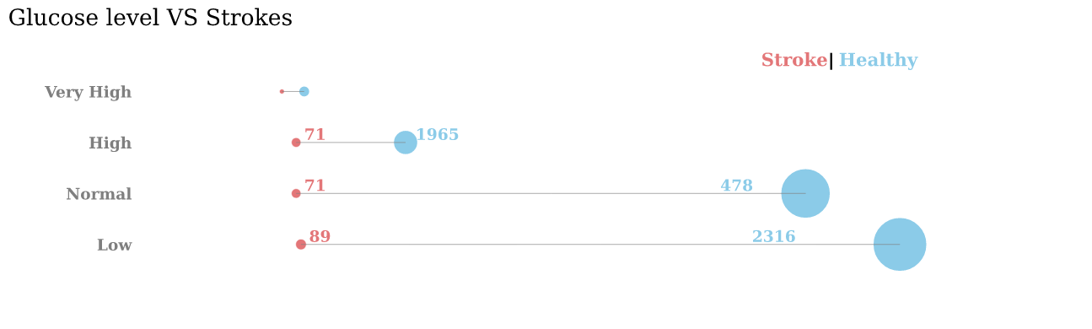
Does body mass index and glucose levels in a person, propel a stroke?
02

Slide 11
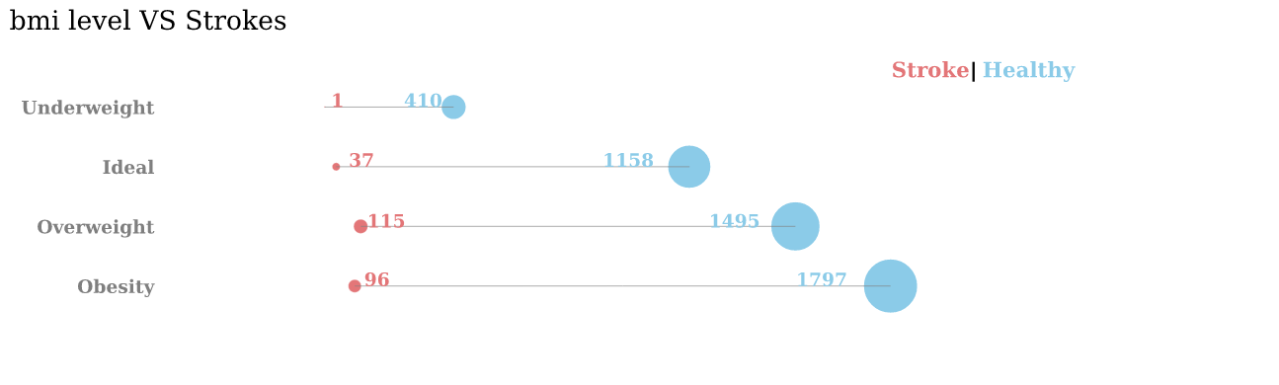
Does body mass index and glucose levels in a person, propel a stroke?
02

Slide 12
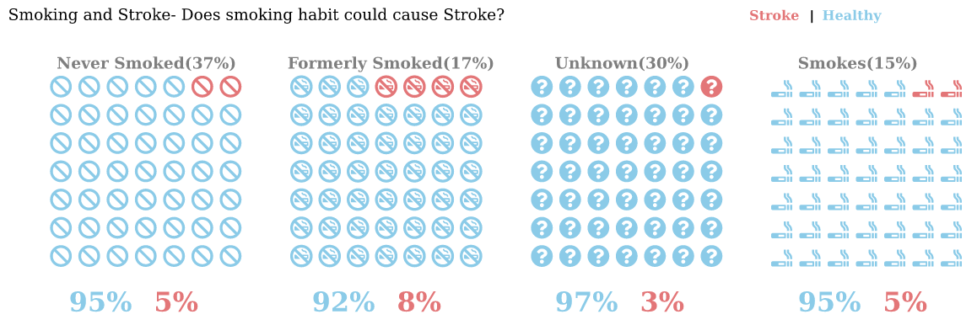
Assumption: Smoking can induce Stroke, is it true?
03

Slide 13
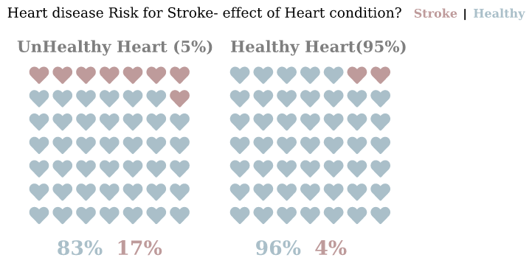
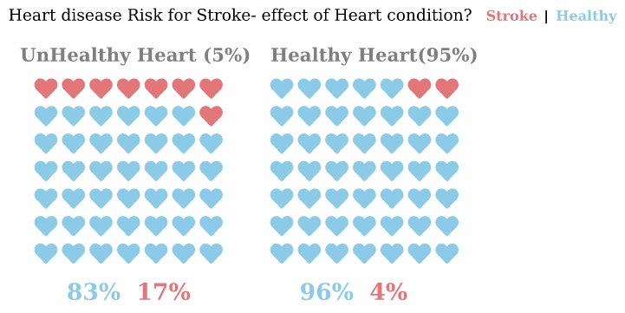
Assumption: Heart with a Heart Disease is prone to Stroke, is it true?
04

Slide 14
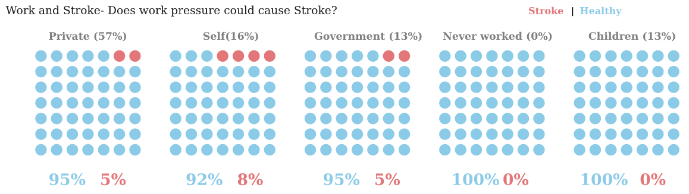
Assumption: Workload results in high blood pressure and that could lead to Stroke.
05

Slide 15
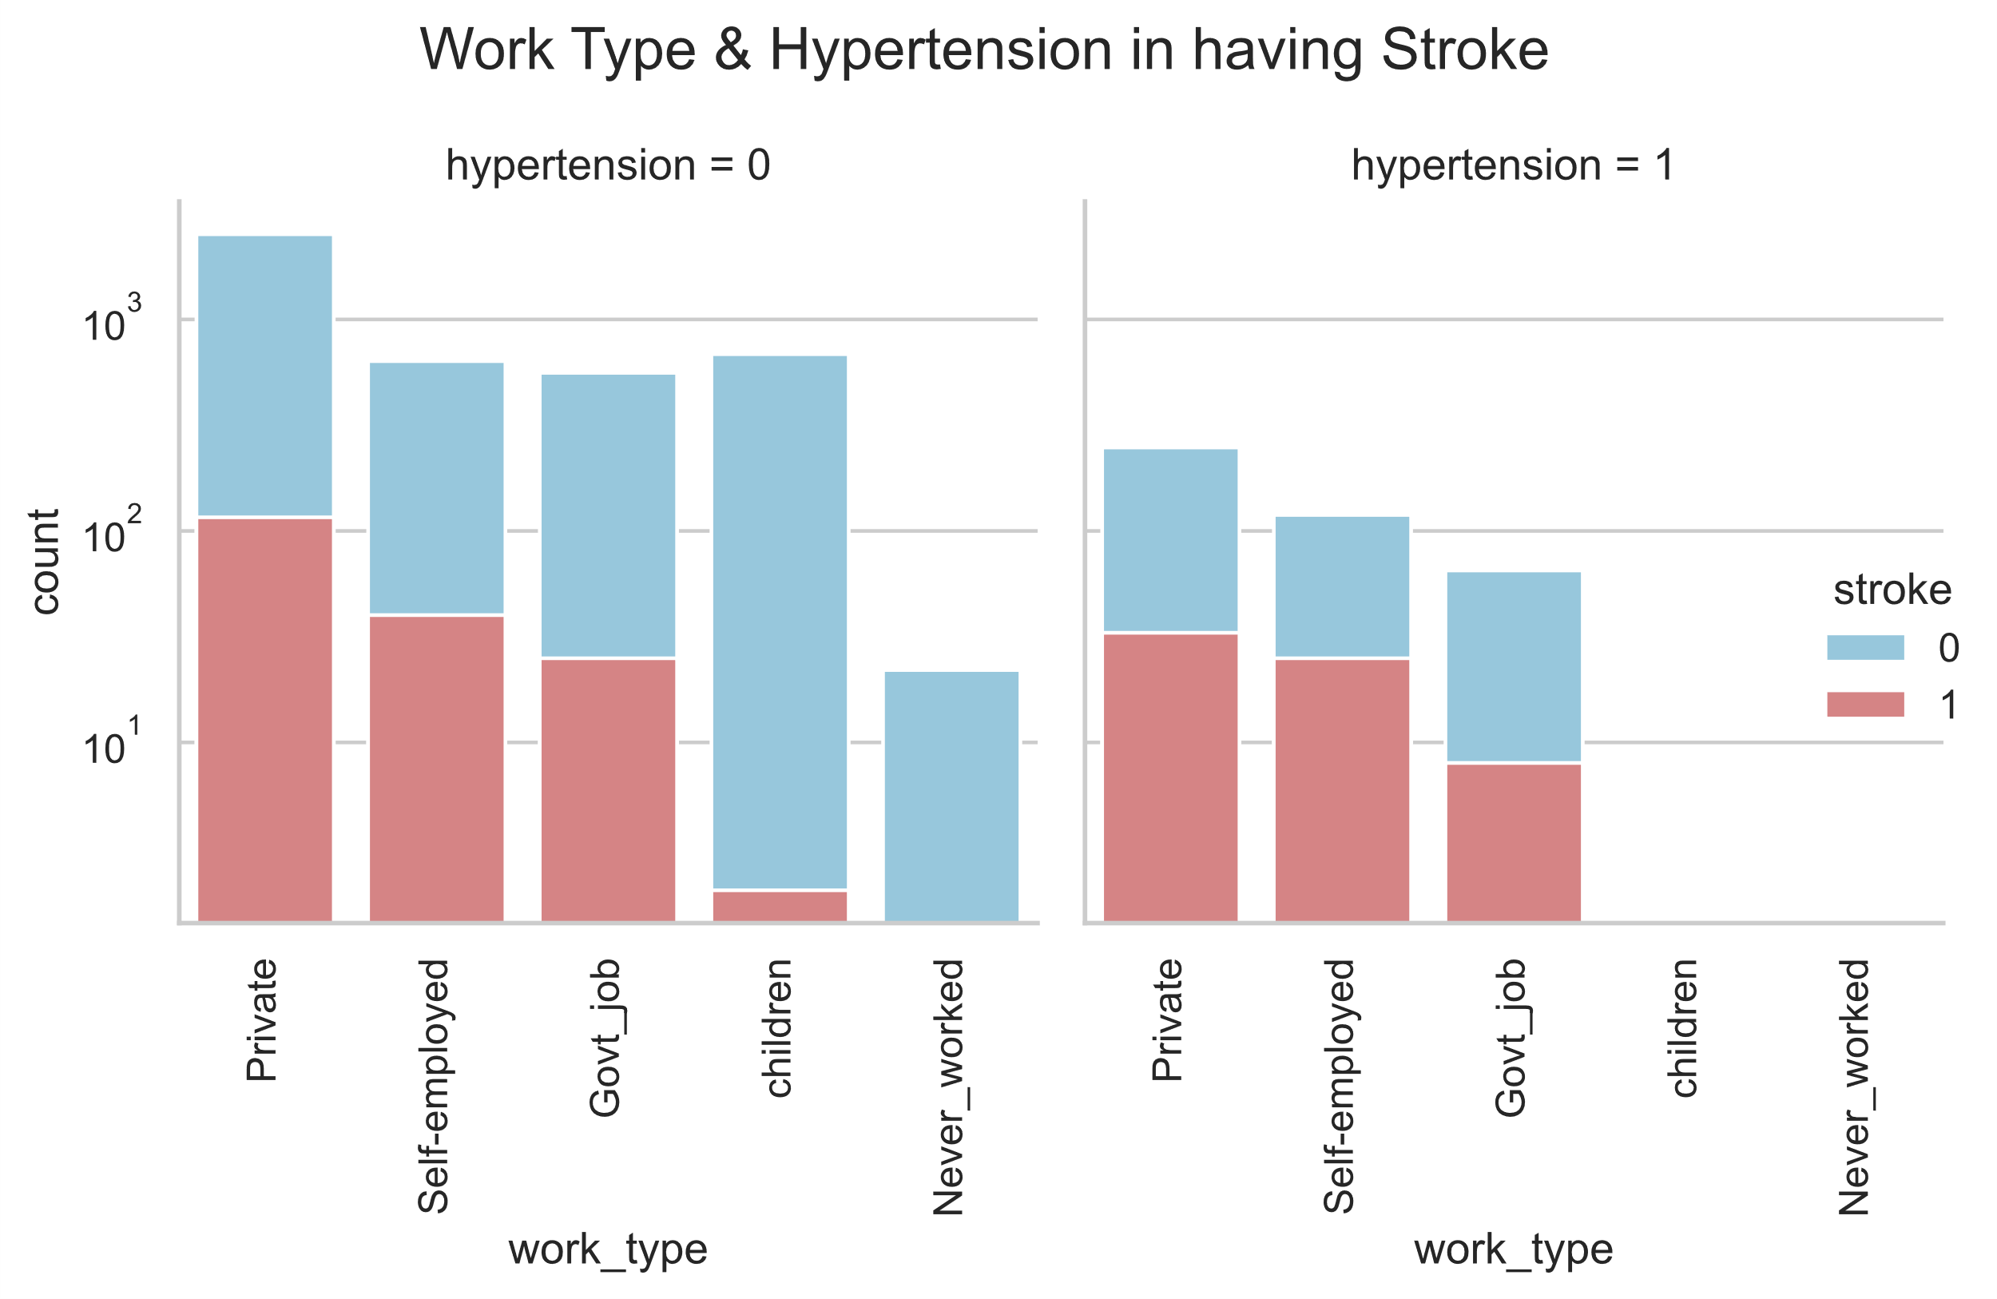
Assumption: Workload results in high blood pressure and that could lead to Stroke
05

Slide 16
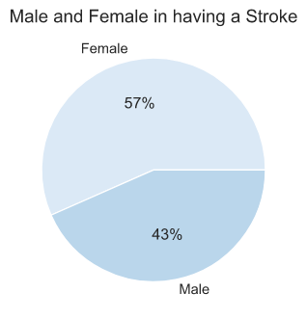
Assumption: Males are most susceptible to strokes due to high work-related stress.
06

Slide 17
Algorithm
Preprocessing
Selecte Features
Models
Oversampling
Oversampling and Undersampling
Stacking

Slide 18
Preprocessing
Drop Null
Label Encoder
Drop
Unnecessary data
Dummies
Scaling

Slide 19
Selected Features
Heart_disease
Age
Hypertension
Ever_married

Slide 20
BUT !
We found that we have a problem of imbalanced data set, namely that target of 1 is less than number of 0.
0
1

Slide 21
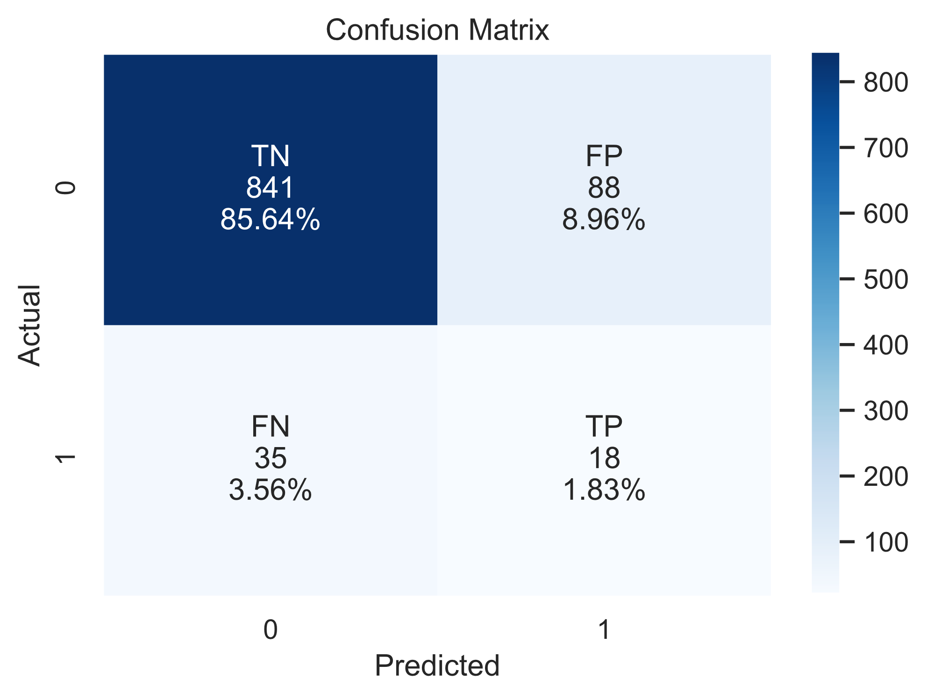

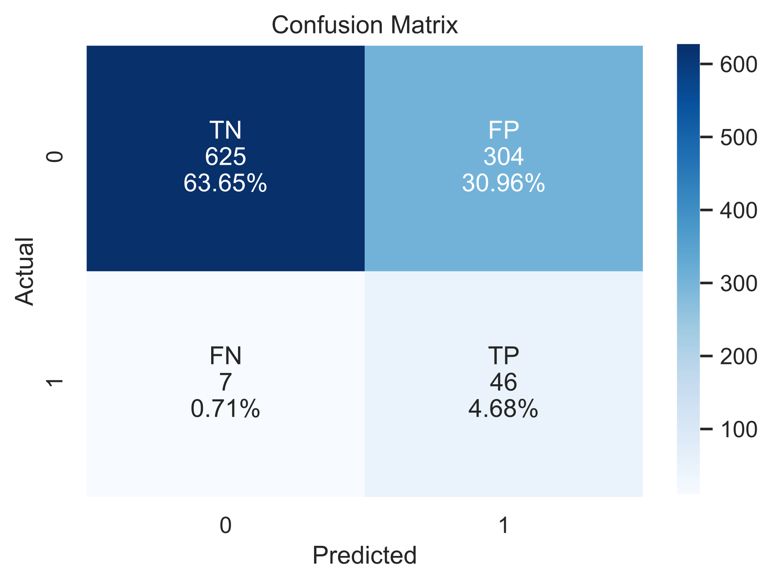
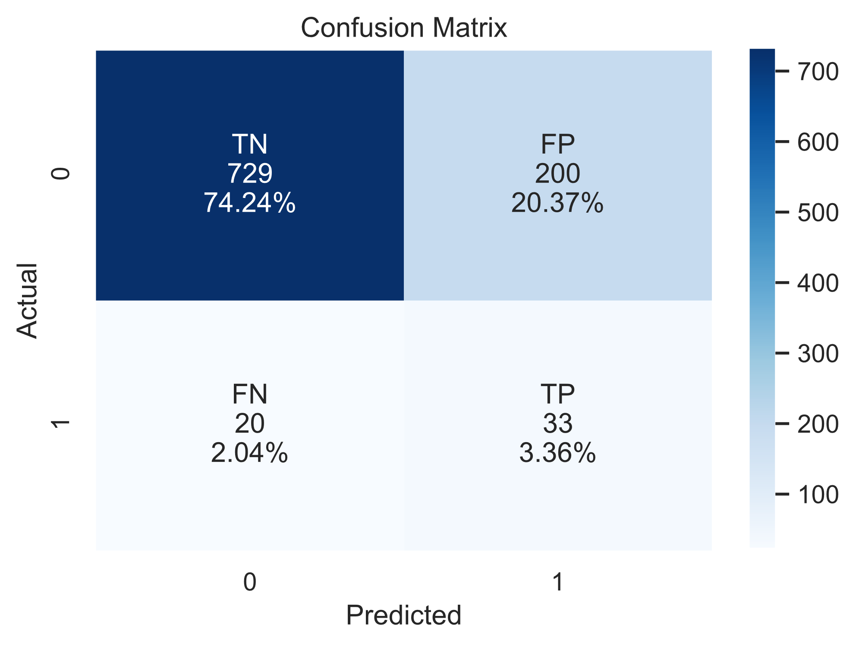
Oversampling
SMOTE
0 → 929 1 → 53
Random Forest
Logistic
Regression
Decision Tree
KNN

Slide 22
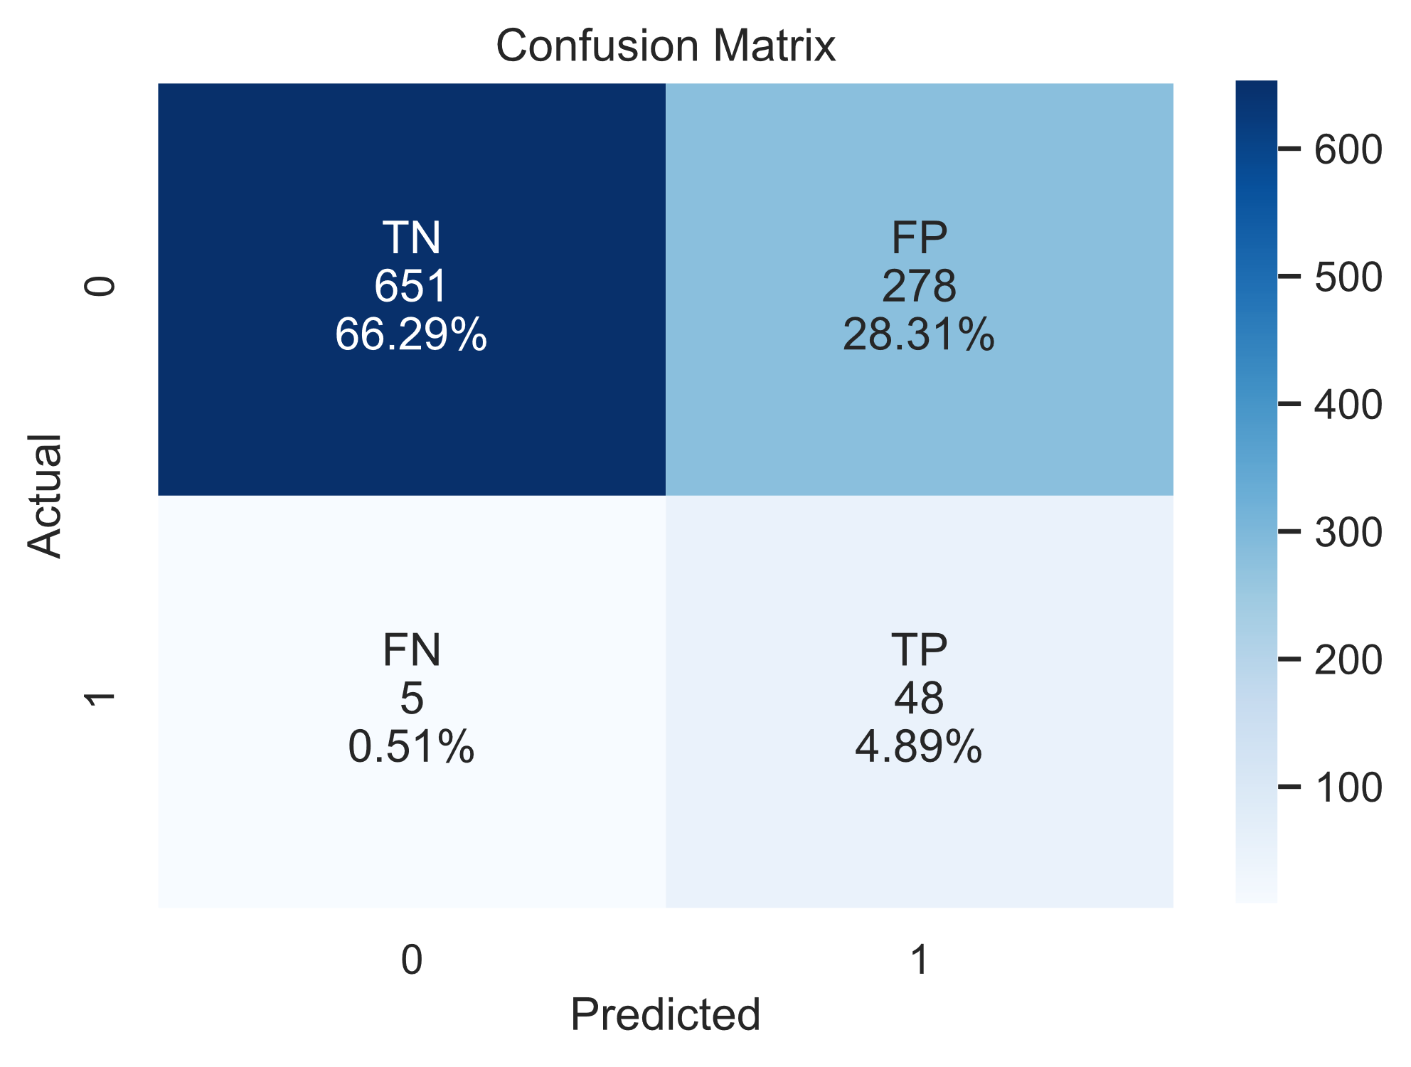

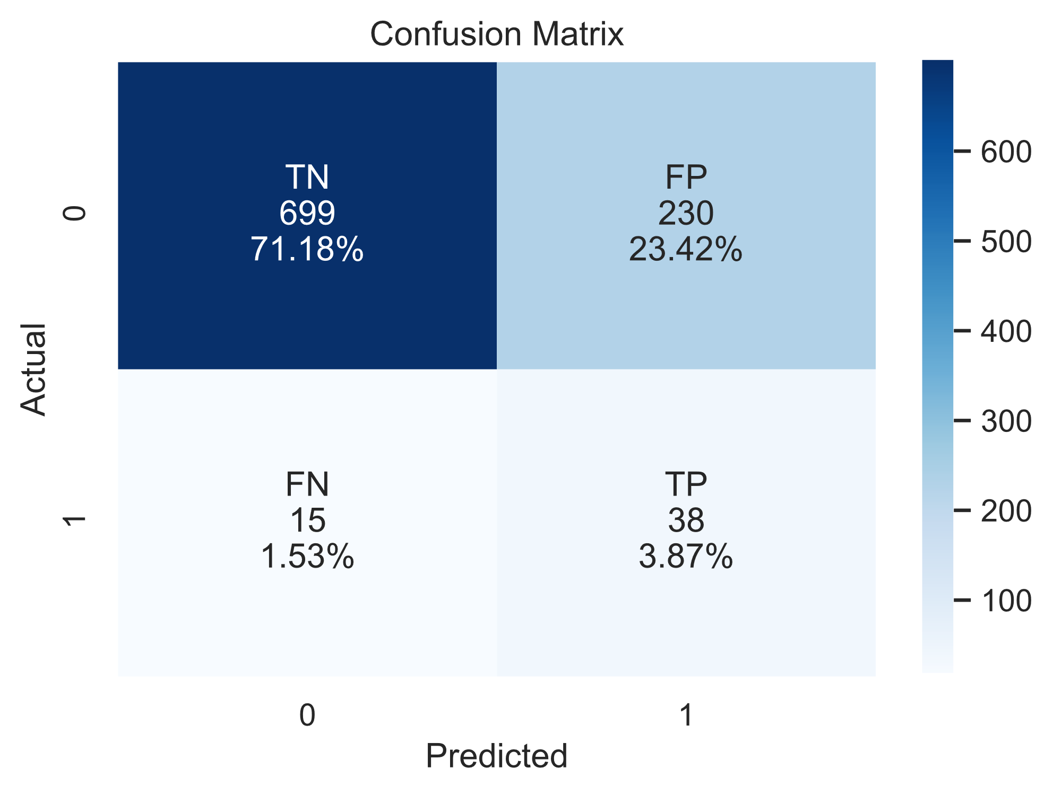


Oversampling
SMOTE
0 → 929 1 → 53
Naive Bayes
XGBoost
Gradient Boosting
SVM
LightGBM

Slide 23




Oversampling &Undersampling
SMOTE + Tomek
0 → 929 1 → 53
Random Forest
Logistic
Regression
Decision Tree
KNN

Slide 24
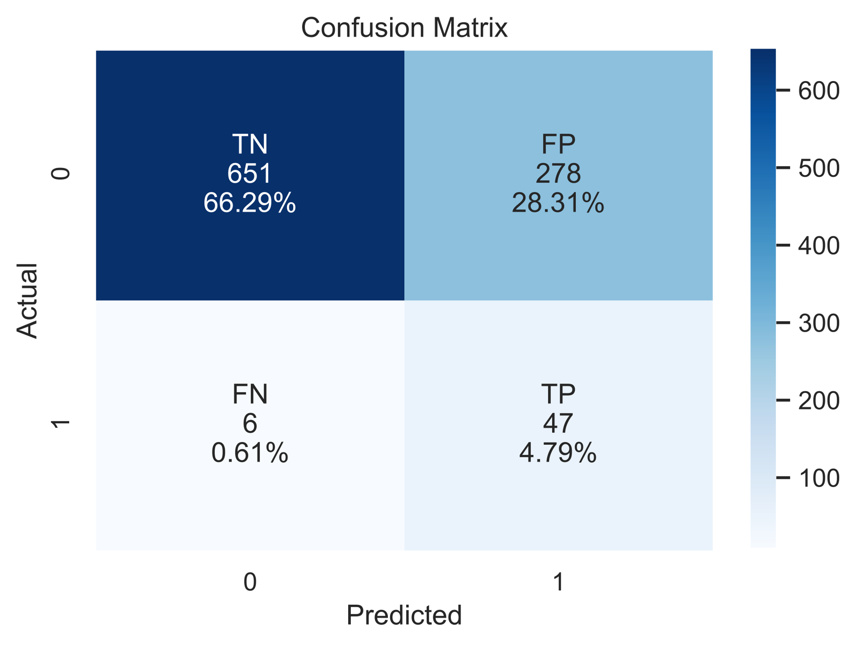




Oversampling & Undersampling
SMOTE + Tomek
0 → 929 1 → 53
Naive Bayes
XGBoost
Gradient Boosting
SVM
LightGBM

Slide 25
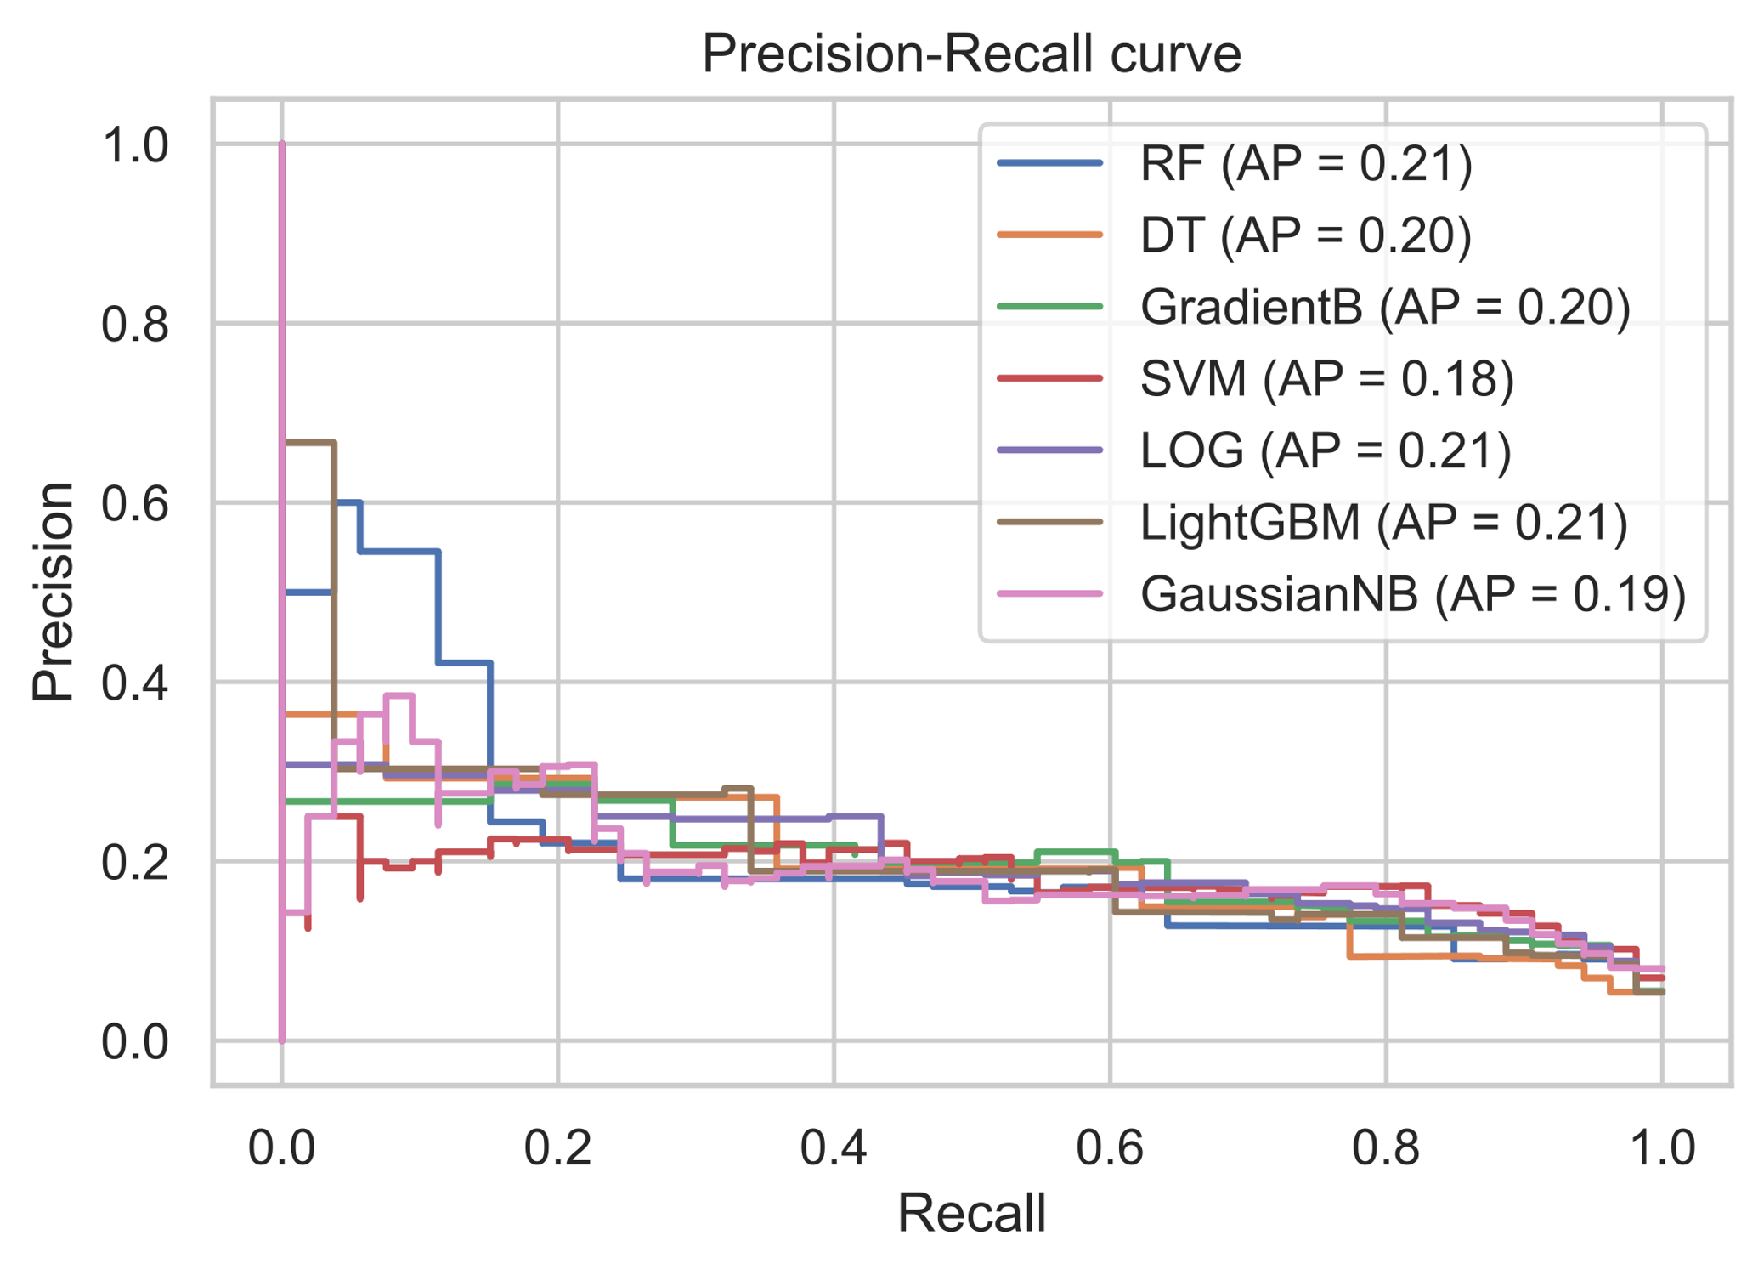
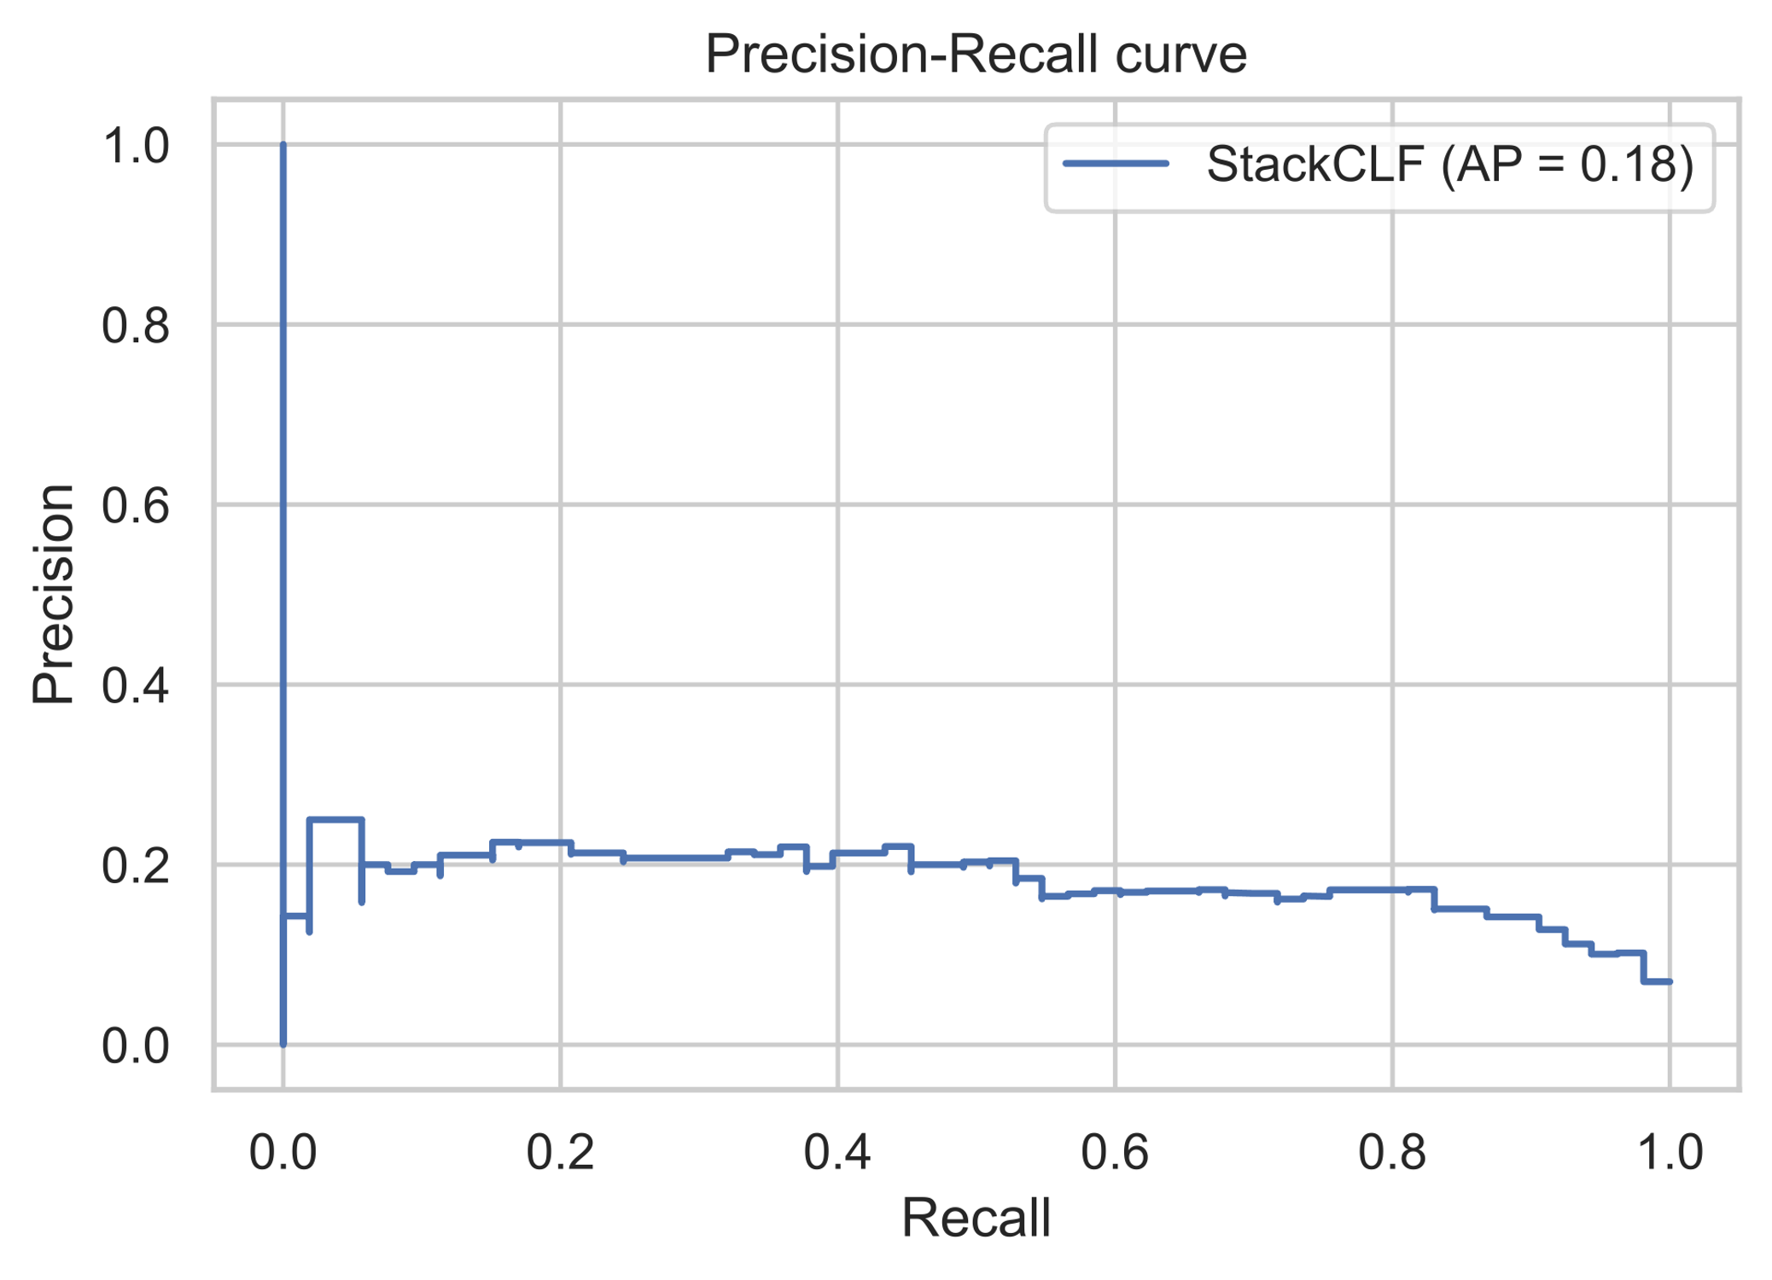
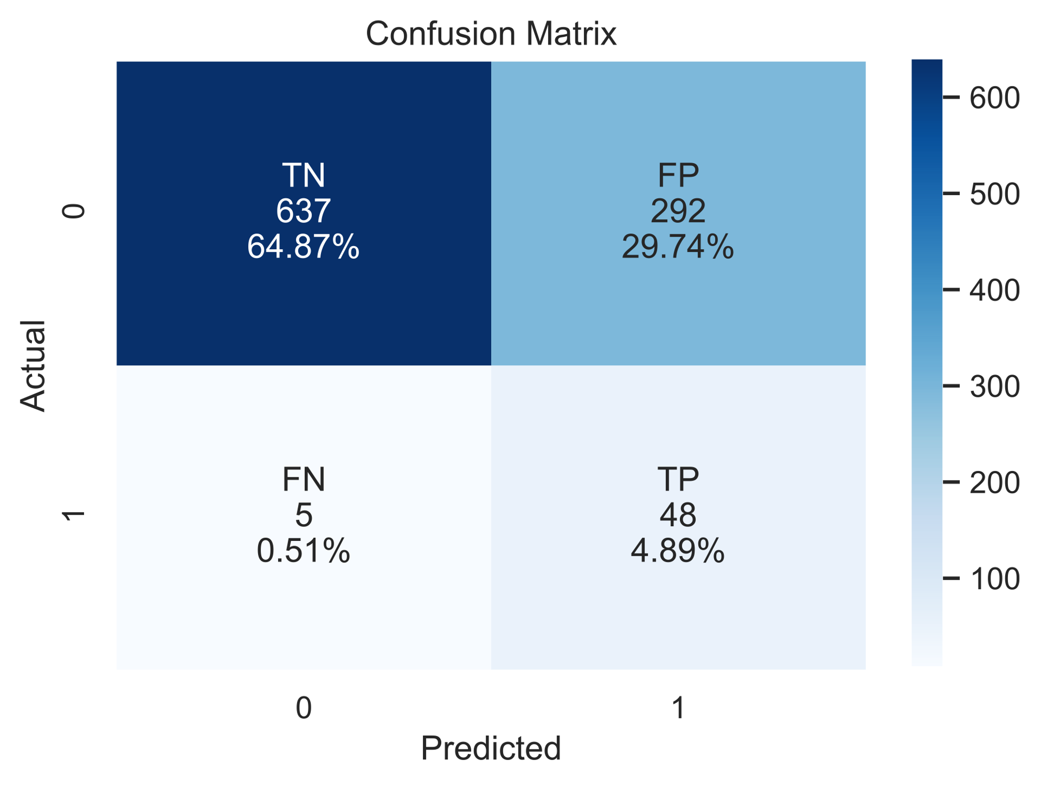
Stacking
Stacking Model
PRC for Models
PRC for Stacking Model

Slide 26
Challanges
01
02
03
Handling Imbalance data
Find a suitable hyperparameter
Long execution time

Slide 27
Tools
Libraries
pandas, numpy, matplotlib, seaborn, plotly, sklearn, imblearn, pywaffle.
Software
Trello, GitHub, Jupyter, VSCode, Word & PowerPoint, Zoom.

Slide 28
Conclusion
Build a platform to predict if any patient is exposed to get a stroke at any time, to call the patient and take the first step to prevent any bad situation.
Do an awareness program that explains all the causes for being exposed to get a stroke, teach people how to do the first medical help until the Ambulance.

Slide 29
Thank you
Feedback ?

